Slide 1



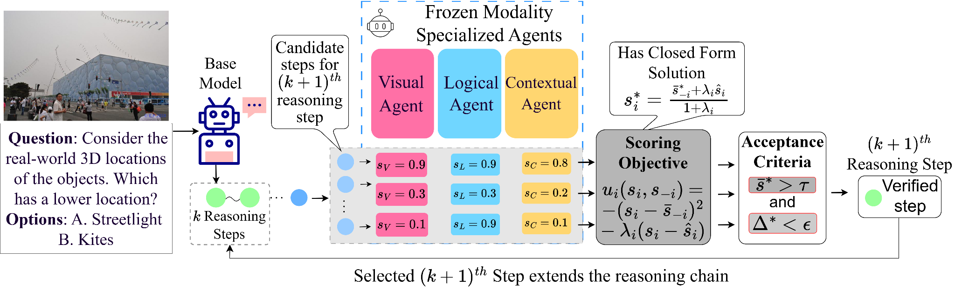
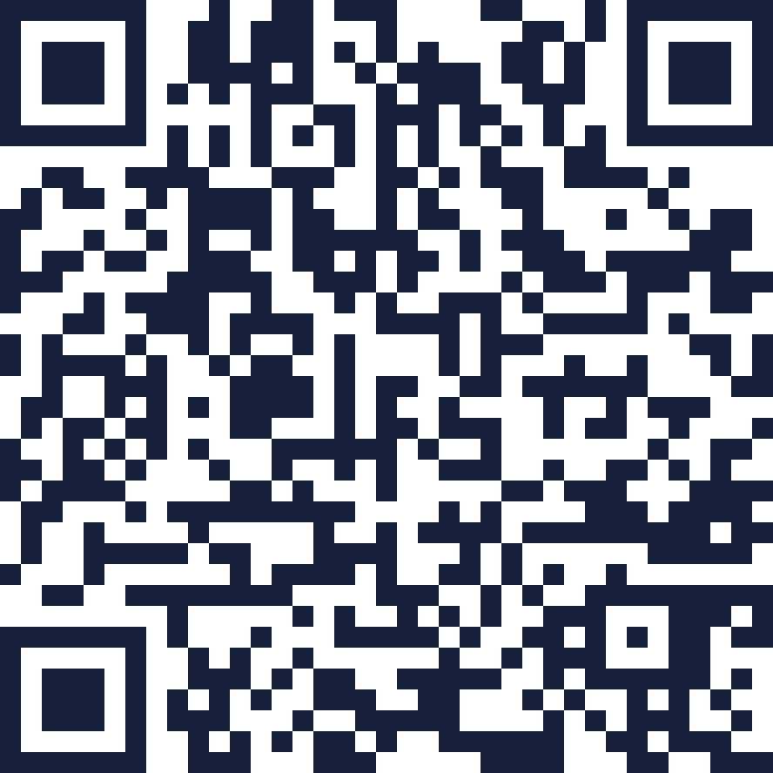
VERDICT: Training-Free Step-Wise Verification of
Microsoft
Multimodal Reasoning via Disagreement-Aware Consensus
Research
Rohit Sinha* · Kunal Tilaganji* · Tanuja Ganu · Nagarajan Natarajan · Amit Sharma · Vineeth Balasubramanian
IIT Hyderabad
Indian Institute of Technology Hyderabad · Microsoft Research * equal contribution
Indian Institute of Technology
The Problem
Key Insight
Contributions
Reasoning chains fail quietly
Disagreement is the signal
1
Coupled scoring, not aggregation.
Individual steps carry gaps that look locally plausible, then cascade into a wrong final answer.
A valid step makes judges converge. When they cannot agree, the step is unstable.
Frozen, modality-specialised judges. No training, no labels.
2
Closed-form consensus.
(0.7, 0.7, 0.7)
Δ* = 0
accepted
The unique equilibrium of a coordination game.
Verification must happen at the step level.
(0.9, 0.3, 0.9)
Δ* ≈ 0.11
rejected
3
Provably not an average.
Same mean - averaging cannot tell them apart.
Dispersion is non-separable in raw scores (Prop. 1).
How VERDICT Works
Results
BENCHMARK | Base | Mean | VERDICT | Δ
3DSRBench | 56.12 | 58.34 | 59.02 | +2.90
CV-Bench-3D | 76.39 | 79.77 | 82.34 | +5.95
CV-Bench-2D | 74.27 | 77.57 | 79.22 | +4.95
BLINK | 48.31 | 50.17 | 51.32 | +3.01
MMStar | 61.25 | 64.14 | 65.88 | +4.63
AI2D | 81.52 | 82.18 | 83.14 | +1.62
Average | 66.31 | 68.70 | 70.15 | +3.84
Three frozen judges score every candidate step in isolation. A closed-form consensus redistributes those scores around a fixed mean. It can never inflate confidence, and the dual criterion decides which candidate extends the chain.
Base
66.31
Mean
68.70
VERDICT
70.15
Accuracy (%) — no benchmark falls below the base model.
Ablations & Analysis
Paper, Code & Project Page
Ranking drives the gain
Stubbornness is asymmetric
Robust to both thresholds
Project page
Dropping ranking costs −1.17 to −2.17; dropping filtering only −0.26 to −1.08.
λ_{V} spans 2.90 pp, λ_{C} only 1.19. Swapping V↔C costs −1.76.
ε plateaus over [0.1, 1.0]; τ = 0.6 is best on five of six benchmarks.
kunaltilaganji.github.io/verdict
Consensus, not averaging
Weaker judges, bigger win
Base-model agnostic
arXiv
Raw Average trails by 2.59-2.95 under the identical dual criterion.
Margin over Mean grows +0.68 (7B) → +0.89 (4B) → +1.21 (2B).
+2.45 to +4.00 across four base-model families, judges held fixed.
arxiv.org/abs/2608.10665
Next:
reward-model ensembles, multi-agent
evaluation and compositional code verification.

